Slide 1

TOPIC : AXIS_banK
Comprehensive Digital Marketing
Project Work
PROJECT DONE
BY:
KINTALI HEMANTH

Slide 2
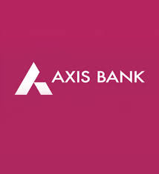

Slide 3

Part 1: Brand study, Competitor Analysis & Buyer’s/Audience’s Persona
Research Brand Identity:
Brand colour: Burgundy and White
Logo:
Mission: It’s mission is to be the preferred financial solutions provider excelling in customer delivery through insight, empowered employees and smart use of technology.
Values : it’s values are − Ethics , Transparency , Teamwork , Ownership ,Customer Centricity.
USP: It is one of the largest private sector financer in Indian agriculture.
Tagline: Badhti ka Naam Zindagi and Dil Se Open.

Slide 4
Part 1: Brand study, Competitor Analysis & Buyer’s/Audience’s Persona
Analyse Brand Messaging: Axis Bank has launched the 'Dil Se Open – Aapke Liye' brand campaign which reaffirms and showcases its human value proposition to its customers. Created by Lowe Lintas, the campaign showcases five unique films inspired by real-life stories of the bank's employees who have truly lived up to their 'Dil Se Open' promise.
Examine the brand's tagline: Dil Se Open is the tagline of axis bank. It means - For your dreams, our eyes are open. For your hopes, our minds are open. every possible window of opportunity. We welcome you with all our hearts.

Slide 5
Part 1: Brand study, Competitor Analysis & Buyer’s/Audience’s Persona
Competitor Analysis: HDFC , ICICI , IDBI.
Competitor 1: HDFC (https://www.hdfcbank.com)
It is one of the big four banks in India. HDFC Bank was incorporated in August 1994 in the name of HDFC Bank Limited, with its registered office in Mumbai, India. It’s usp is one of the big four banks in India.
2. Competitor 2: ICICI (https://www.icicibank.com/)
ICICI is the most efficient and tech Savvy bank in the Indian banking industry was established by ICICI, as a wholly owned subsidiary in 1994 in Vadodara. The bank was founded as the Industrial Credit and Investment Corporation of India Bank, before it changed its name to ICICI Bank.
It’s USP is the most efficient and tech Savvy bank in the Indian banking industry.
Competitor 3: IDBI (https://www.idbibank.in/)
It is a Development Financial Institution constituted in 1964, as a wholly-owned subsidiary of the Reserve bank of India, for providing financial aid to industries and assisting the development institutions (like NSE, NSDSL, SIDBI, etc) . (USP)It is a focused development financial institution.

Slide 6
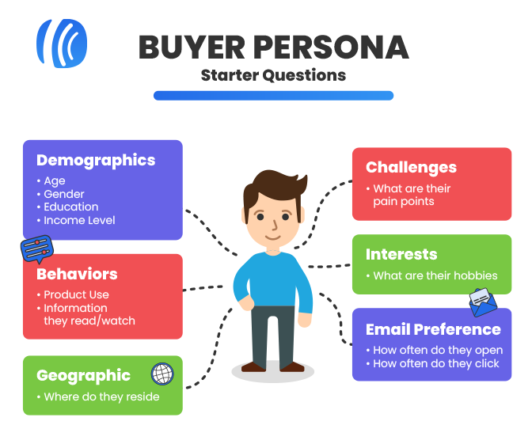
Buyer's/Audience's Persona:
Axis bank segments the market based on Psychographics & demographics variables like income & occupation, age, social class etc. It targets the business class & tech savvy customers for whom time is more important and who would prefer convenience in banking with bank.
BRAND : Axis bank Age : 16 to 60+ Location : All over India Gender : All genders Target audience : Middle class and high income people.

Slide 7
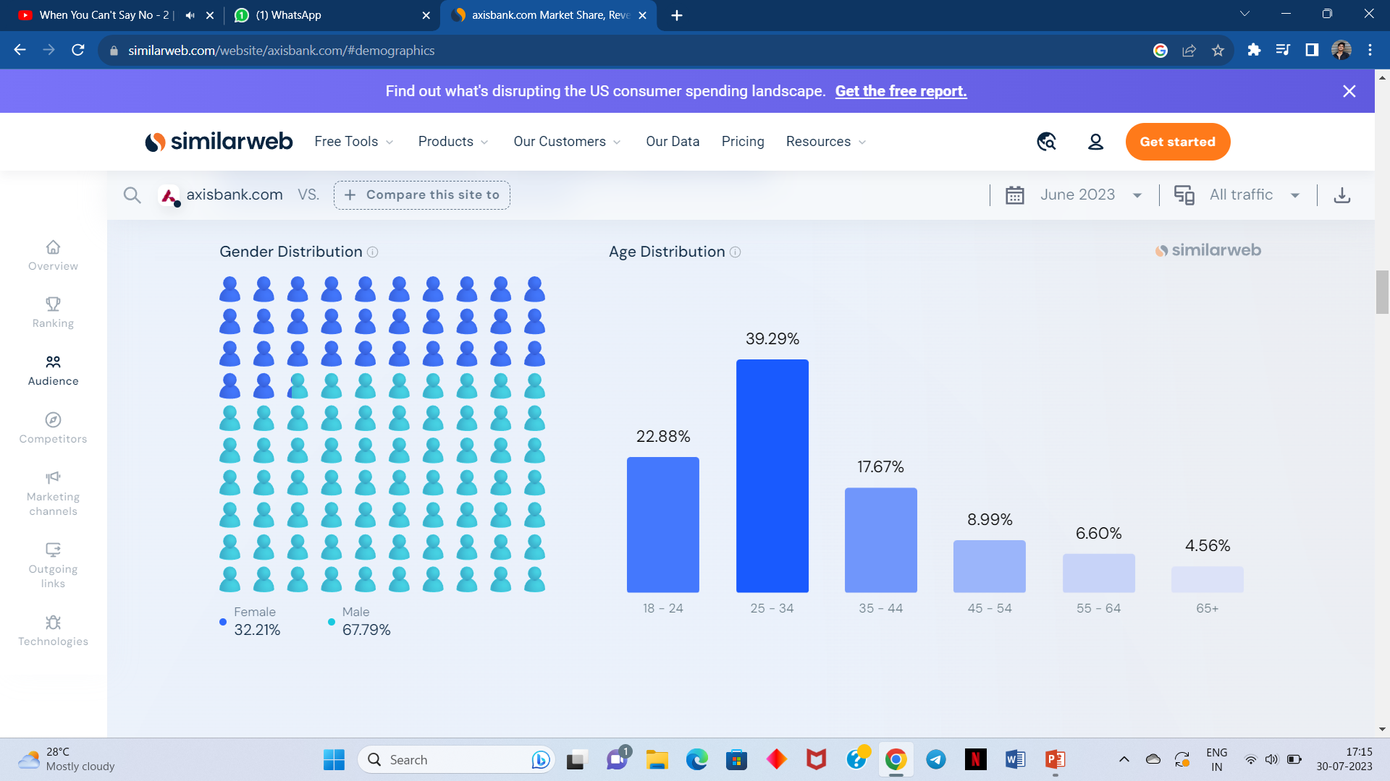
Audience Demographics : Audience composition can reveal a site's current market share across various audiences. axisbank.com's audience is 67.79% male and 32.21% female. The largest age group of visitors are 25 - 34 year olds (Desktop).

Slide 8
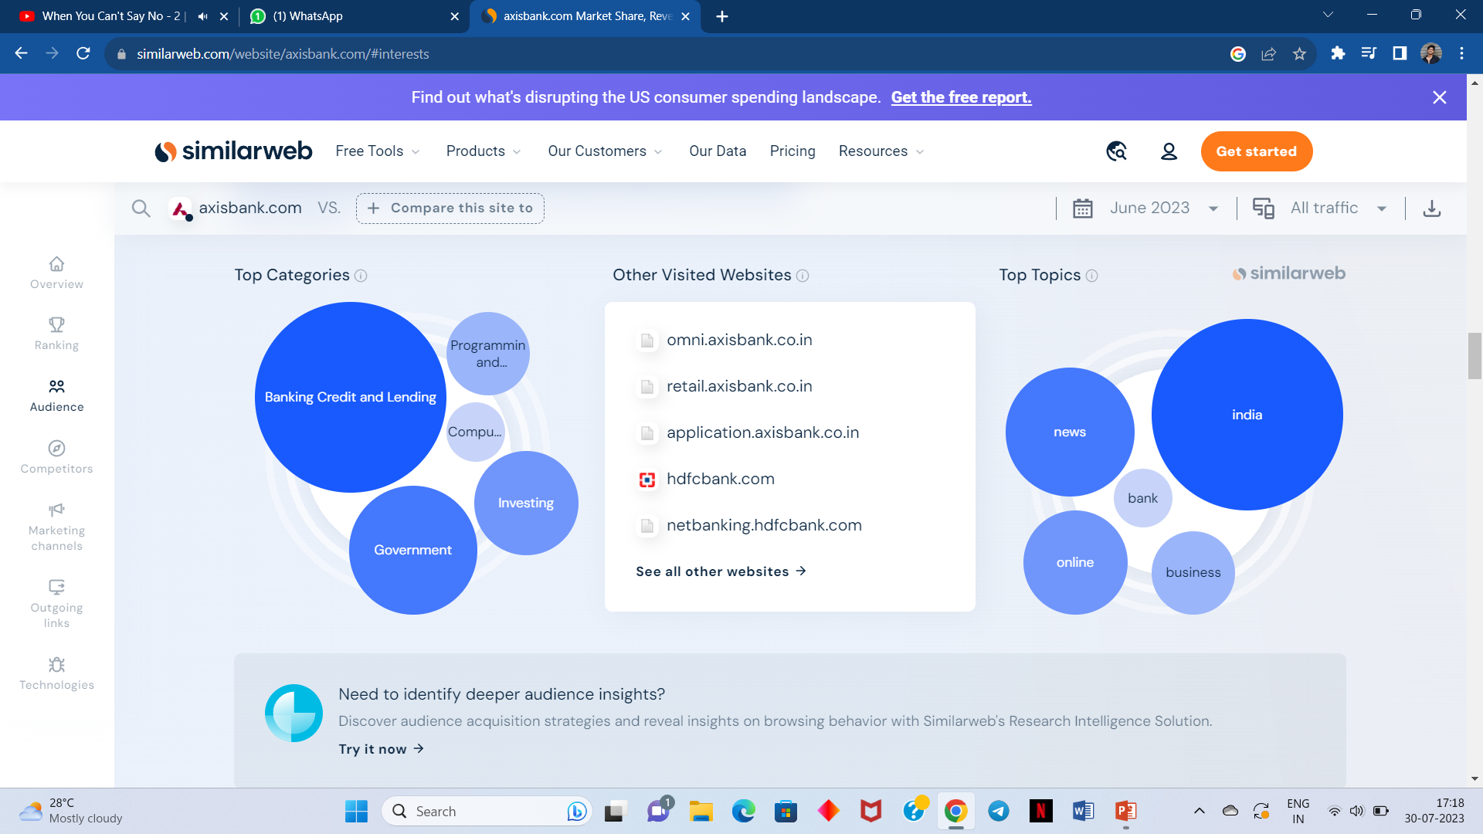
Audience Interests : Audience interests reveal key details on the browsing interests of axisbank.com's visitors. Axis bank audience is interested in Finance > Banking Credit and Lending & india.

Slide 9
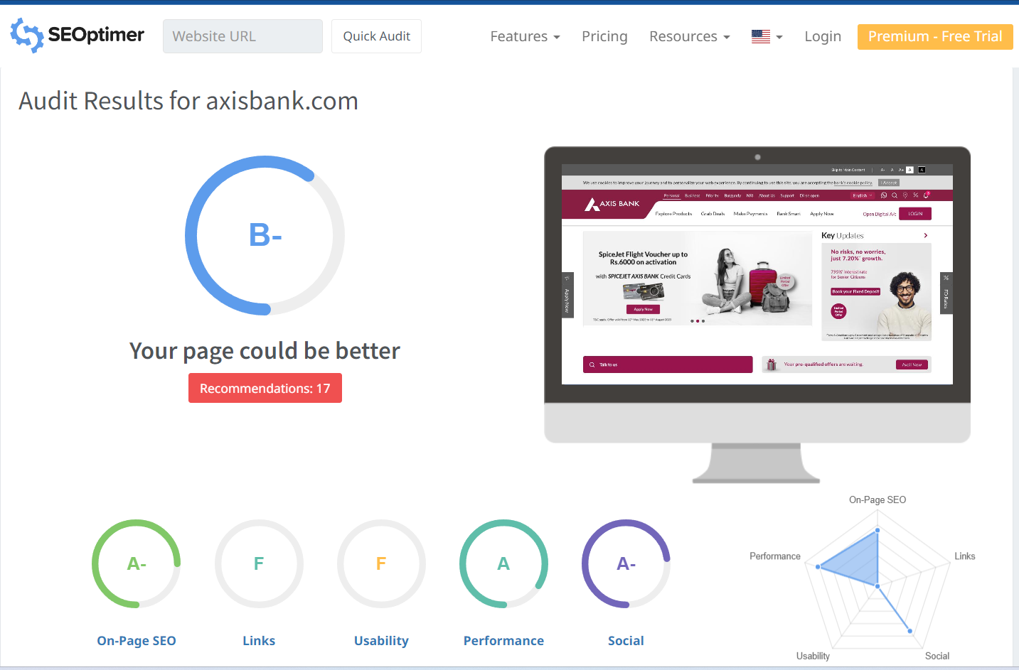
Part 2: SEO & Keyword Research
SEO Audit Of Axis Bank :

Slide 10
Keyword Research:
Axis Bank Research Objectives:
1) To observe the various product and service offering under retail banking and the other day to day branch operation activities. 2) To observe customer query handling so as to ensure customer satisfaction. 3) To observe and analyze any shortcomings in the branch operations.
Brainstorms seed Keyword:
Seed keywords are the main terms that describe your niche, product, or service. They are the foundation of your keyword research, as they help you generate more specific and relevant keywords. You can start by brainstorming a list of seed keywords based on your own knowledge, customer feedback, competitor analysis, or industry trends. You can also use tools like Google Trends, Answer the Public, or Uber suggest to find popular and related seed keywords.

Slide 11
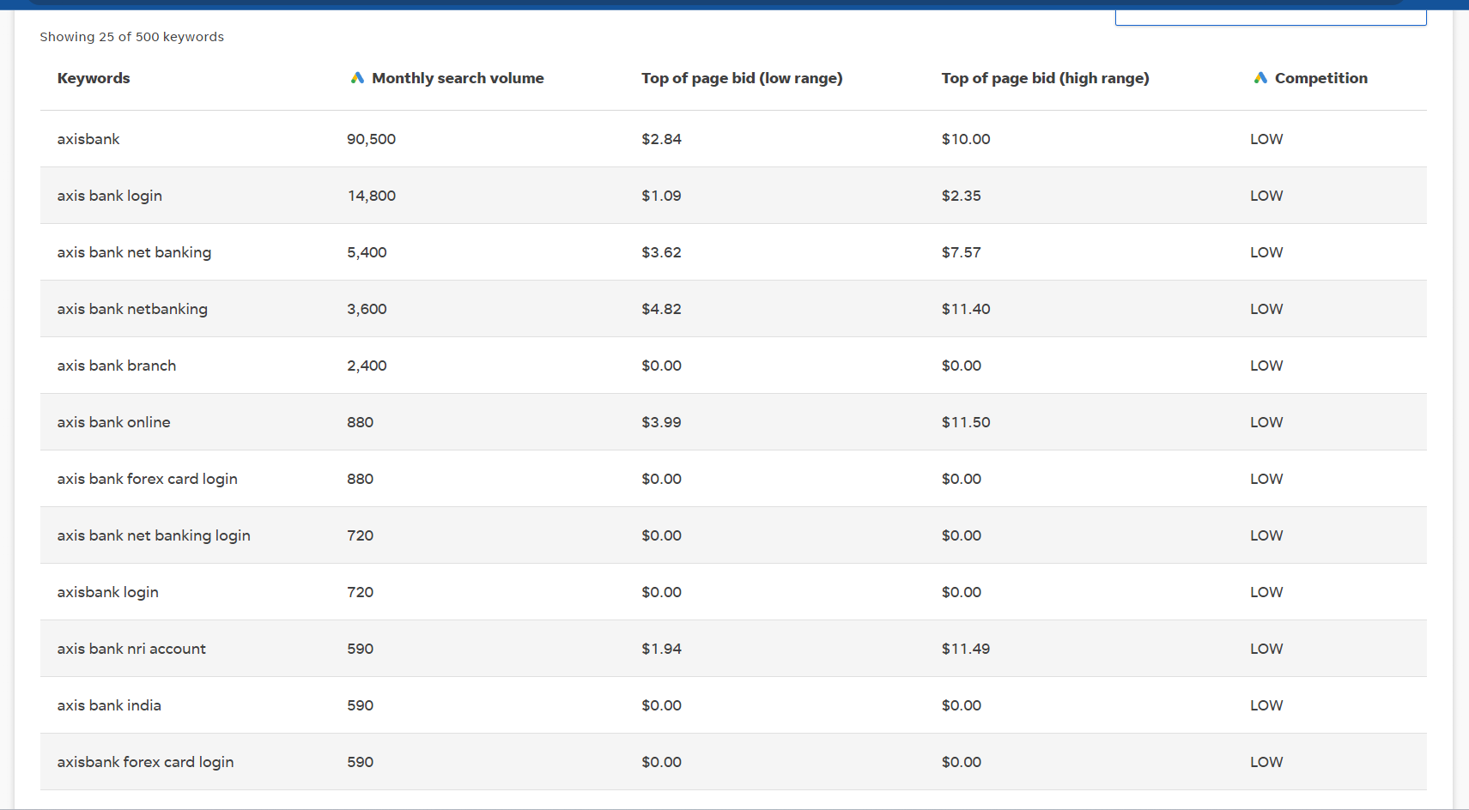
Keyword Research Tools: SEMRUSH

Slide 12
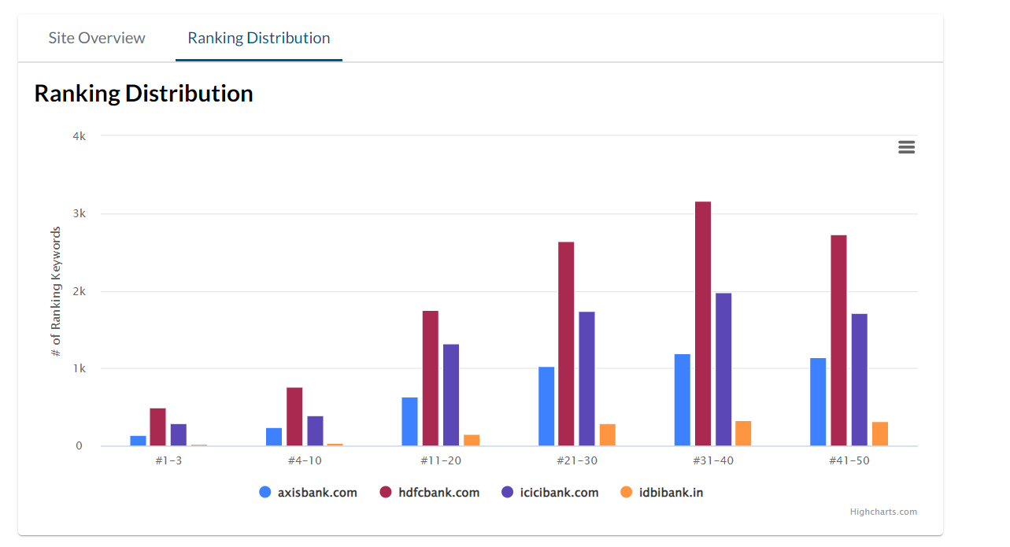
Analysis of Competitor Keywords: The competitors are 1.HDFC 2.ICICI 3.IDBI

Slide 13
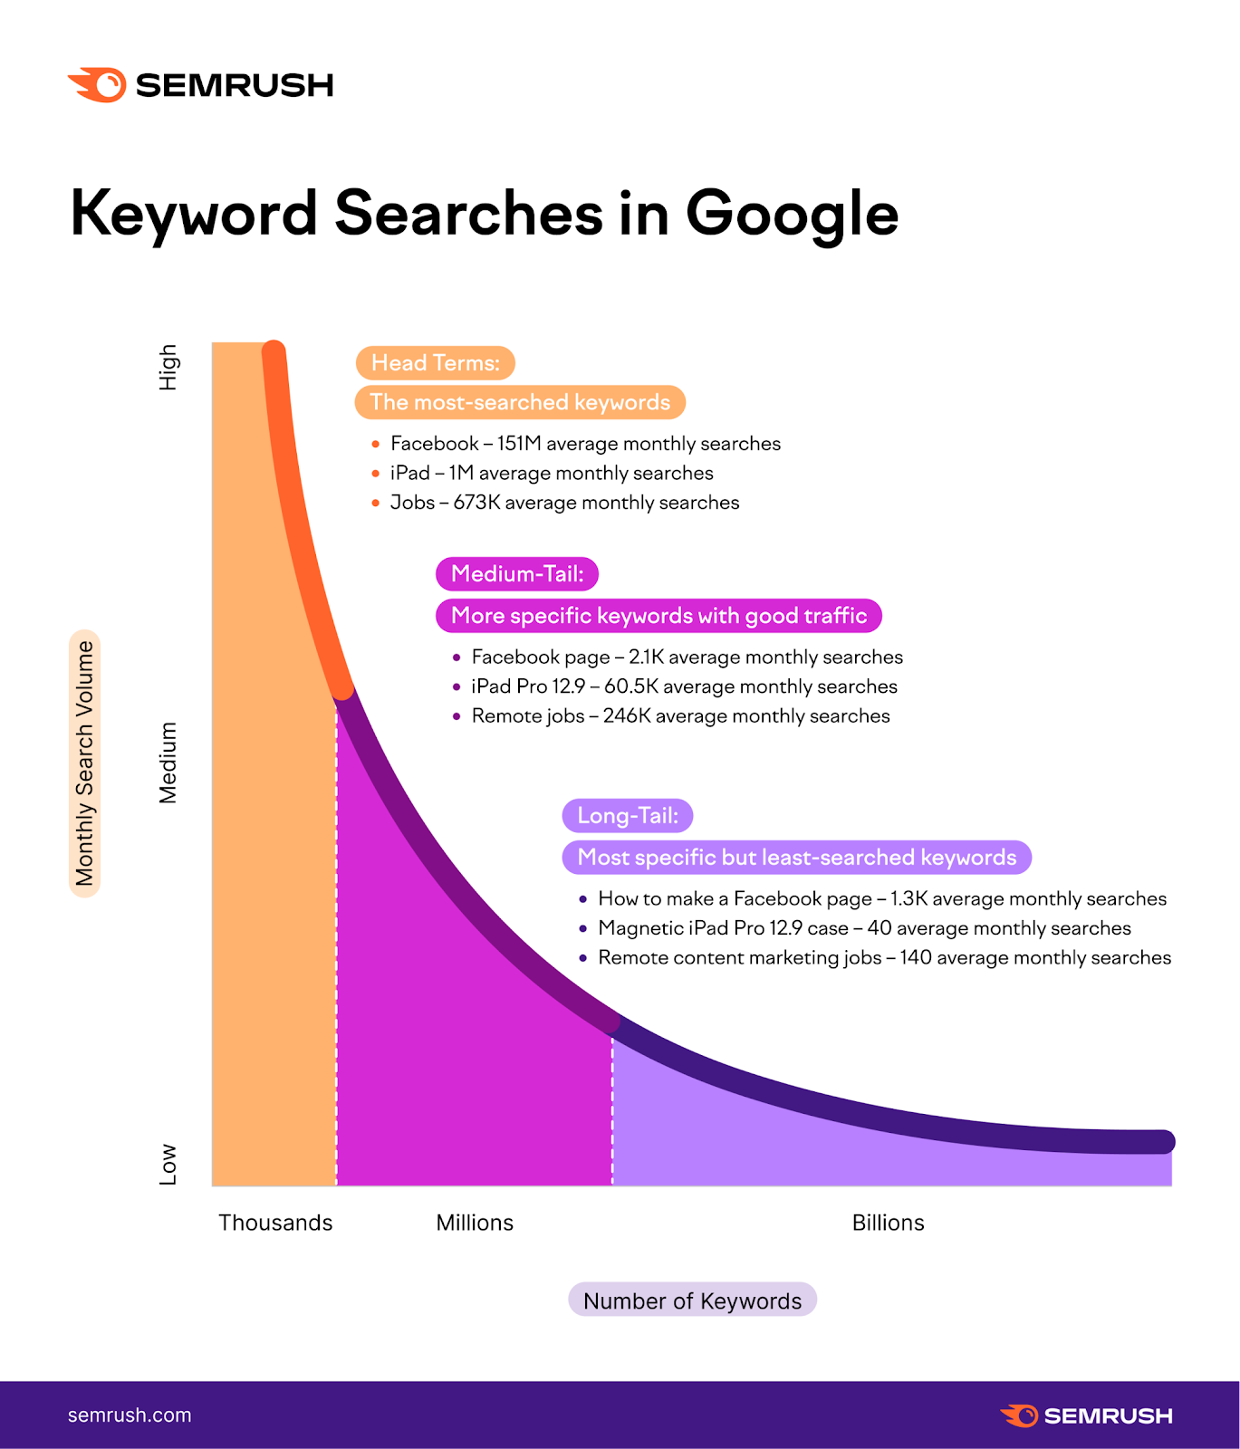
Long-Tail Keywords :
It include the most words of any type. Long-tail keywords
are typically phrases, questions or full product names.
Due to the specific nature of these keywords, they
be the most targeted keywords in your strategy.
Even though these keywords have low search volumes,
their specificity makes it more likely for conversions to happen.
Someone searching for “best smartphones” is in-market for a
new phone. However, they are still researching and comparing
prices.

Slide 14
One Page Optimization : Meta-Tag optimization
Meta tags are the most fundamental part of SEO and making sure that your site's pages have a good, solid foundation of optimization. These are the tags that you add to your page's header to describe the page using syntax that Google understands.
Meta Tag Description for SEO :
1.Keep it under 160 characters. 2.Create distinct summaries for each page. 3.Avoid duplicate meta descriptions on your website. 4.Use sentence case. 5.Be accurate, descriptive, and concise. 6.Match search intent. 7.Only include your target keyword where it makes sense.

Slide 15
CONTENT OPTIMIZATION : Essentially, content optimization, or SEO (search engine optimization), is the process of optimizing your content to make sure that it's more visible through the web. Search engine robots will rank highly optimized content higher on a search engine page than non-optimized content. Optimizing Content for SEO : 1.Find the Right Topic and the Right Keyword. 2.Find Semantically Related Keywords. 3.Establish Your Structure. 4.Manage Keyword Density. 5.Be Aware of Cannibalization. 6.Add Visuals. 7.Interlink. 8.Cover the Topic in Depth.

Slide 16
THE PROCESS OF CONDUCTING KEYWORDS RESEARCH AND THE SEO RECOMMENDATIONS :
Keyword research is the process of finding and analyzing keywords your ideal website visitors enter into search engines. That enables you to target the most effective keywords in your content strategy.
Keywords are words or phrases people use to find information or products in search engines. For example, if you wanted to buy food for your puppy, you might type the keyword “food for puppies” into Google.
Properly conducted keyword research helps you to:
Better understand your niche and target audience
Tailor your content strategy to the needs of your audience
Get more relevant organic traffic to your website
On the other hand, without keyword research, you might end up targeting keywords nobody is using. Or not targeting any keywords at all. (Both of these are common problems on many websites.)
In this guide, we’ll cover the three steps of keyword research:
Finding keywords: how to find relevant keywords with keyword research tools
Analyzing keywords: how to prioritize keywords using key metrics and criteria
Targeting keywords: how to identify primary keywords and nail their search intent

Slide 17
Challenges faced during the research and analysis phase, as well as the key insights gained from the keyword research process. :
What is keyword research?
Keyword research is the process of finding and analyzing search terms that people enter into search engines with the goal of using that data for a specific purpose, often for search engine optimization (SEO) or general marketing. Keyword research can uncover queries to target, the popularity of these queries, their ranking difficulty, and more.
Why is keyword research important?
Keyword research helps you find which keywords are best to target and provides valuable insight into the queries that your target audience is actually searching on Google. The insight that you can get into these actual search terms can help inform content strategy as well as your larger marketing strategy. People use keywords to find solutions when conducting research online. So if your content is successful in getting in front of our audience as they conduct searches, you stand to gain more traffic. Therefore, you should be targeting those searches.
How to Research Keywords for Your SEO Strategy ?
It take’s 5 steps to research the keywords. They are :
Make a list of important, relevant topics based on what you know about your business.
Fill in those topic buckets with keywords.
Understand How Intent Affects Keyword Research and Analyze Accordingly.
Research related search terms.
Use keyword research tools to your advantage.

Slide 18
Part 3: Content Ideas and Marketing Strategies
Content calendar of JULY month : Axisbank
Sunday | Monday | Tuesday | Wednesday | Thursday | Friday | Saturday
 |  |  |  |  |  | 01.Welcome July Shared a post on Instagram.
02. | 03. Financial tips Monday | 04. | 05. Share the bank's commitment to sustainability for a greener future. | 06. | 07.Posted a story (quiz) on Instagram https://instagram.com/stories/axisbank100/3154603939950044544?utm_source=ig_story_item_share&igshid=MTc4MmM1YmI2Ng== | 08. Best Investment Options - Educate the audience about various investment
09. | 10. Blog https://www.axisbank.com/progress-with-us-articles/managing-credit/why-keeping-your-credit-card-active-is-important | 11. | 12. #Travel wednesday - Share travel tips and information about Axis Bank's travel-friendly financial services. | 13. | 14. Fun Fact Friday - Share another intriguing fact to keep the audience engaged. | 15.
16. | 17. | 18. | 19. | 20. Promotion video https://drive.google.com/file/d/16mQ3yxDsSOnAap8L0CWnd_IyX2XAr0zE/view?usp=drive_link | 21. | 22.
23. | 24. | 25. | 26. | 27. | 28. | 29.
30. Recap the highlights on the month. | 31.

Slide 19
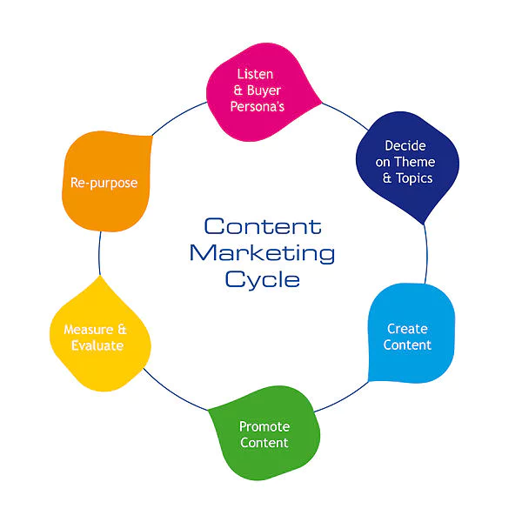
Reflect on the content ideas and marketing strategies process? Content marketing is a marketing strategy used to attract, engage, and retain an audience by creating and sharing relevant articles, videos, podcasts, and other media. This approach establishes expertise, promotes brand awareness, and keeps your business top of mind when it's time to buy what you sell.

Slide 20
Part 4: Content Creation and Curation (Post creations, Designs/Video Editing, Ad Campaigns over Social Media and Email Ideation and Creation)
Post Creation:
Format 1 : Blog article (https://www.axisbank.com/progress-with-us-articles/managing-credit/why-keeping-your-credit-card-active-is-important).
Aim : To promote activation of credit card for customers.
Date : 10th July
Idea : Credit card activation helps in preventing fraudulent activities. The cardholder can use the credit card for purchasing purposes as soon as he/she activates it.
Topic : Why to keep our credit card active ?
Note* : For more details click on the link.

Slide 21
Format 2 : Video (https://drive.google.com/file/d/16mQ3yxDsSOnAap8L0CWnd_IyX2XAr0zE/view?usp=drive_link) tap the link to see the video.
Aim : To promote our brand to the public.
Date: 20th July
Idea : introduce your brand, talk about your purpose and goals, and solve pain points.
Topic : Giving a clear explanation of axis bank through a video.
Format 3 : Creative (https://www.instagram.com/p/CvCxph0x8SB/?utm_source=ig_web_copy_link&igshid=MzRlODBiNWFlZA== )
Aim : To increase public audience.
Date : 1st July
Idea : promoting the brand name and about brand through the post on Instagram.
Topic : Posting of brand logo and identity on social media.

Slide 22
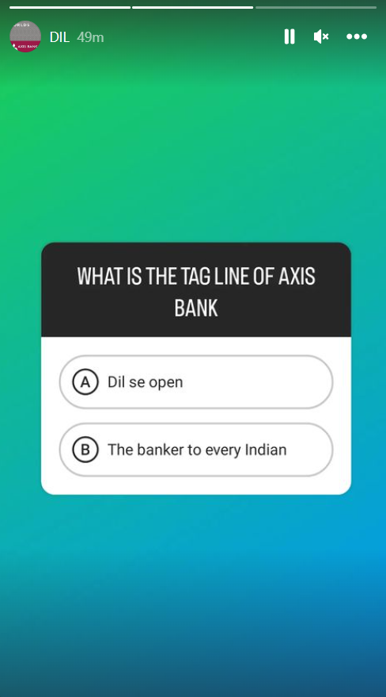
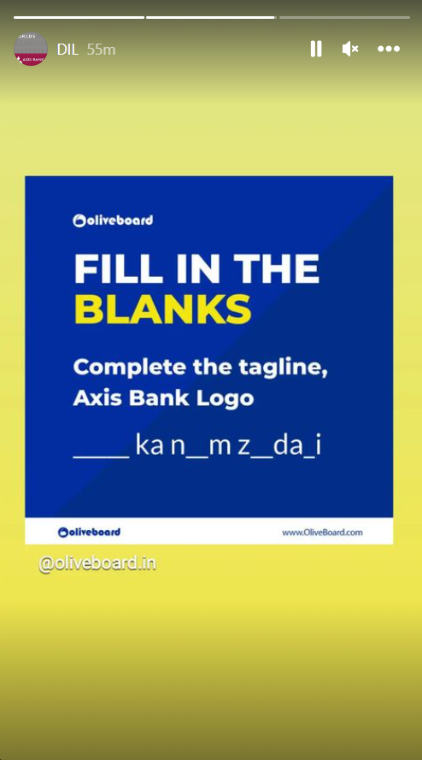
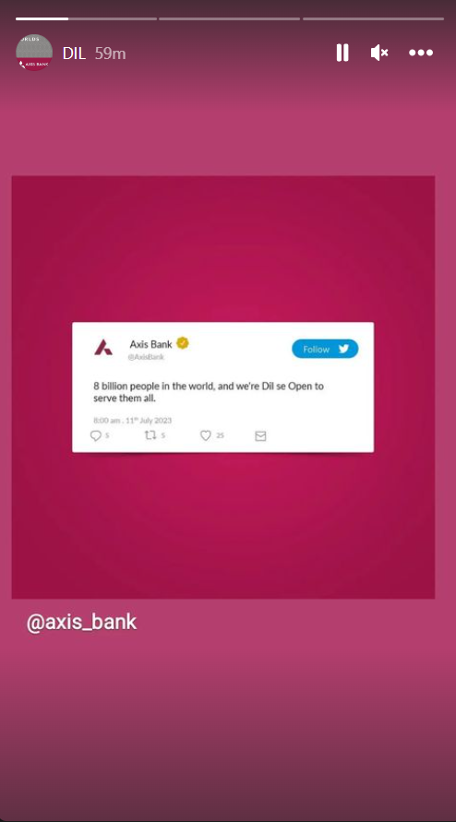
Part 4: Content Creation and Curation (Post creations, Designs/Video Editing, Ad Campaigns over Social Media and Email Ideation and Creation)
Instagram Story

Slide 23
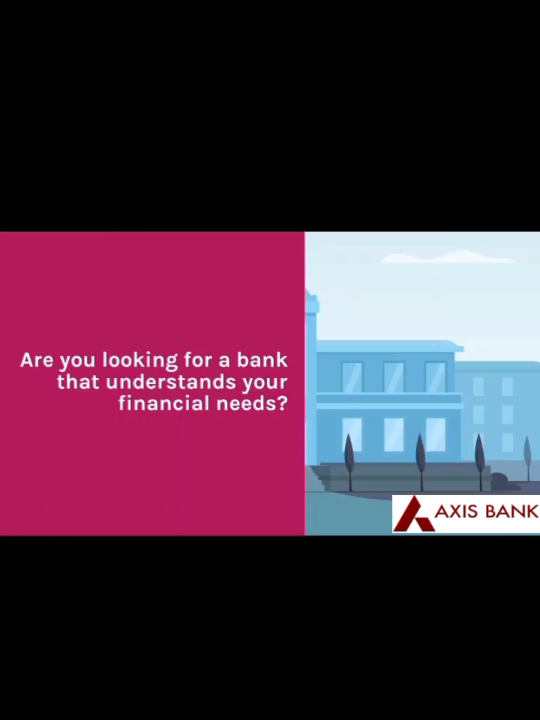
VIDEO:
Designs/Video Editing

Slide 24
Part 4: Content Creation and Curation (Post creations, Designs/Video Editing, Ad Campaigns over Social Media and Email Ideation and Creation)
Social Media Ad Campaigns
Ad Campaigns over Social Media:
Come up with 3 ad campaigns each covering one of the mentioned goals: brand awareness, driving website traffic, or generating leads

Slide 25
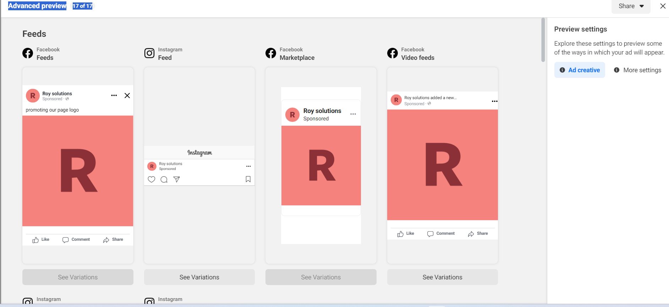
Advertising goals : Creating brand awareness to public/audience. Audience Targeting : age : 18 to 60 , gender : all genders , Location : over all india.
https://fb.me/bkQYRCnWp1w9U7

Slide 26
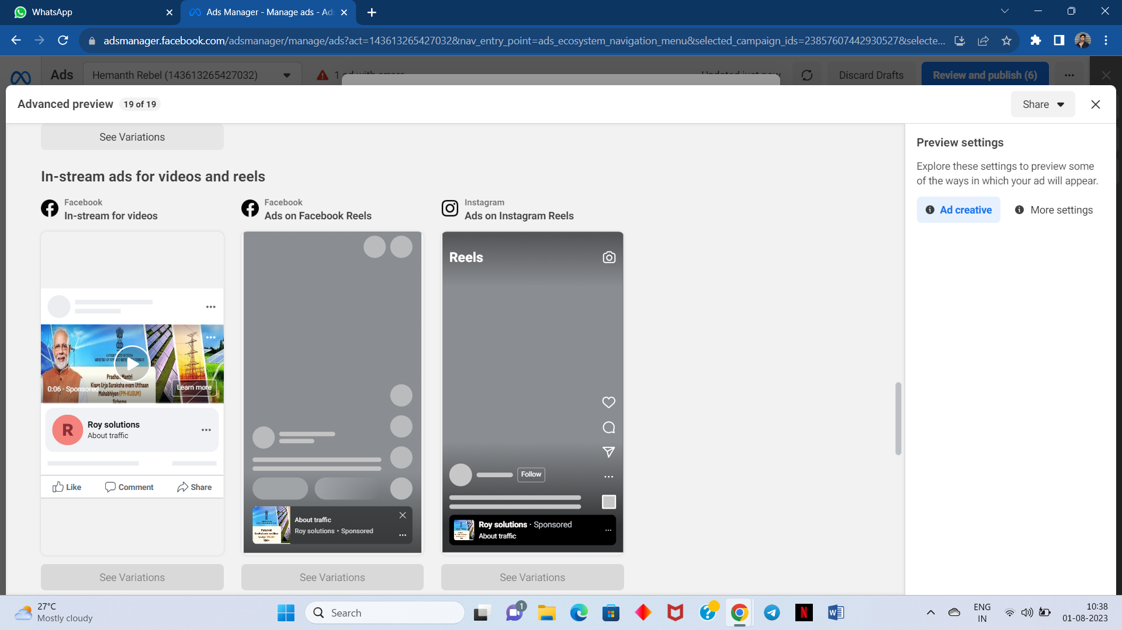
Advertising goal : Driving website traffic. Advertising Targeting : Age – 18 to 60, Gender – all genders , Location – India.

Slide 27
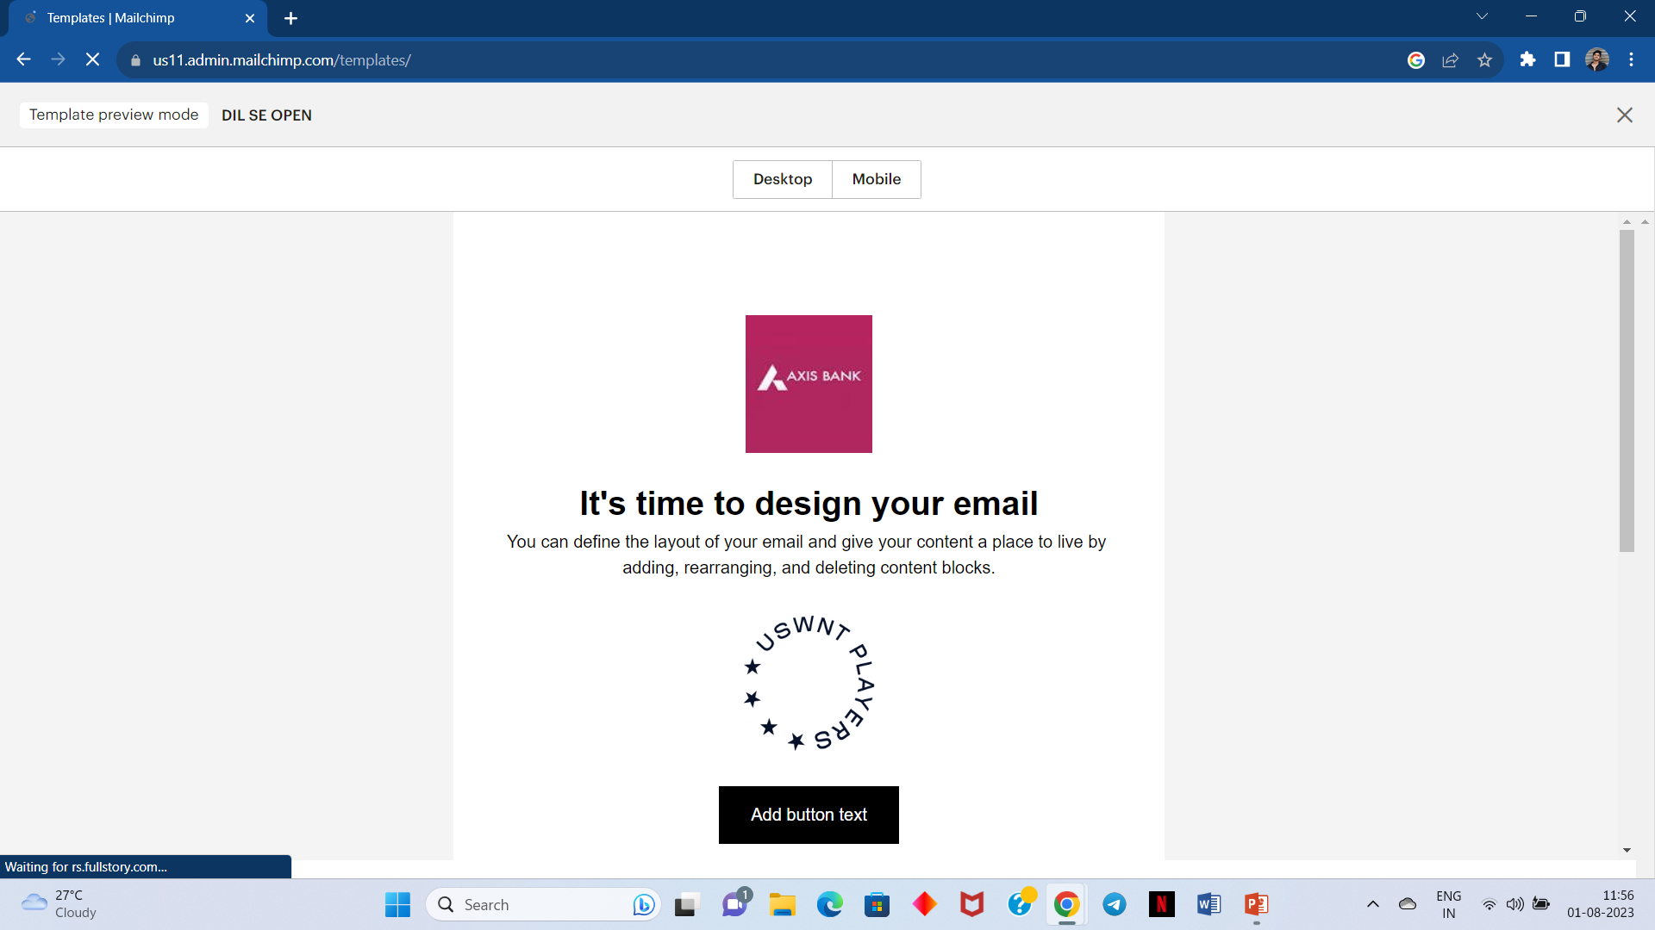
Email Ad Campaign 1 - Brand Awareness
(insert emailed image)

Slide 28
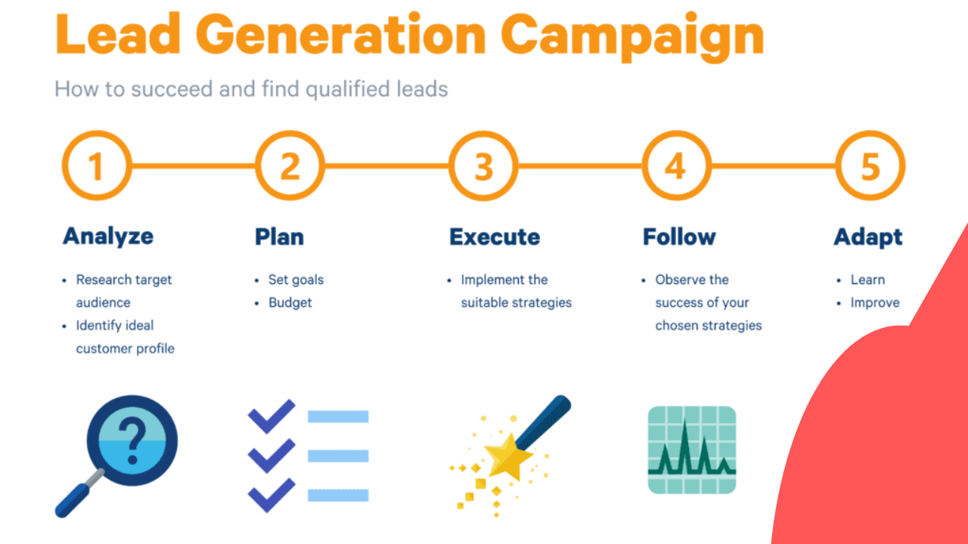
Email Ad Campaign 2 - Lead Generation
(insert emailer image)

Slide 29
Part 4: Content Creation and Curation (Post creations, Designs/Video
Editing, Ad Campaigns over Social Media and Email Ideation and Creation)
Reflect on the content creation and curation process, discussing the challenges faced and lessons learned.
Content creation is the process of generating topic ideas that appeal to your buyer persona, creating written or visual content around those ideas, and making that information accessible to your audience as a blog, video, info graphic, or other content formats.
Challenges faced :
Don't let the hardship be everything. Rest, exercise, and make time for wellness where you can. ...
Don't be ashamed of failures, mistakes, or struggles. ...
Avoid defensiveness. ...
Keep asking questions. ...
Connect with others. ...
Look back to find your lessons of experience.

Slide 30
The END

